Slide 1




Russ Peterson Jr.
May 16 – 17, 2017
@RussPetersonJr

Slide 2

Our Roadmap
Your Presence
  Presentation #1
Preparing
Developing
  Presentation #2
Delivering
  Presentation #3

Slide 3

Satori
Page 51

Slide 4

Unit One:
Presentations and Communication

Slide 5
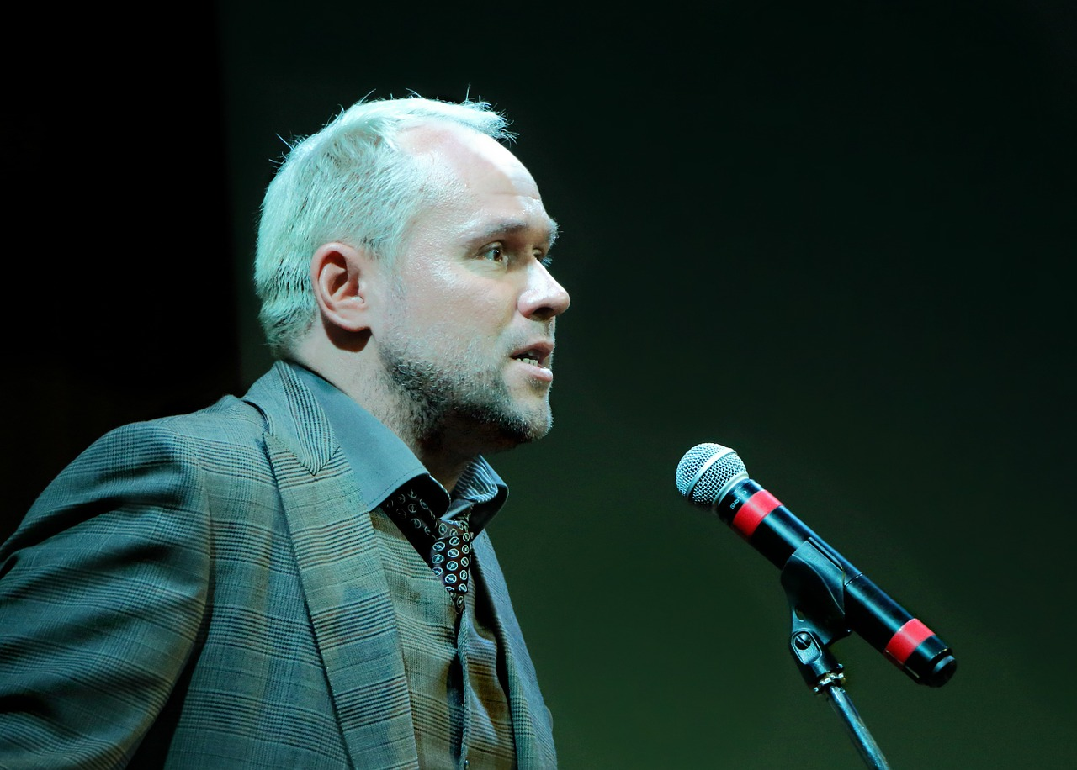
What Makes a Presentation Poor?
workbook - page 2

Slide 6

Overcoming Anxiety
#2 fear in America
75% of speakers have anxiety
Keys to overcoming anxiety:
  Know your subject
  Prepare for questions
  Rehearse your delivery
workbook - page 3

Slide 7

Presentation #1
2-3 minute presentation
Presentation about you
(vacation, job, family, hobby)
Feedback will focus on your:
  Organization
  Objectives
  Communication
  Delivery

Slide 8
Talking Stain Video

Slide 9
Common Distractions
Words
(Um, uh, so, and)
Voice
(projection, pauses, speed)
Body Language
(dancing, rocking, fidgeting, hands)

Slide 10
Communication Factors
workbook - page 6

Slide 11
VERBAL – The Words
VOCAL – Your Voice
VISUAL – Body Language

Slide 12
VERBAL – The Words
VOCAL – Your Voice
VISUAL – Body Language

Slide 13
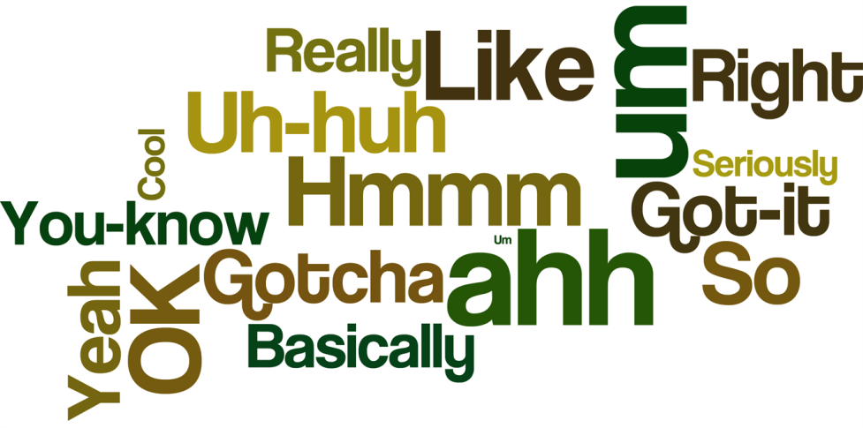
Filler Words
Replace filler words with _______
  Be aware
  Get comfortable with silence
  Slow down
  Read out loud
silence
workbook – page 7

Slide 14
VERBAL – The Words
VOCAL – Your Voice
VISUAL – Body Language

Slide 15
Poor Vocal Delivery
Terrill Poor Delivery Video

Slide 16

Pauses
1-Second Pause
  Audiences will HEAR
2-Second Pause
  Audiences will PROCESS
3-Second Pause
  Audiences will FEEL
workbook – page 8

Slide 17

How can I improve… Verbal Communication?
Clarity
  Good Blood, Bad Blood
  Irish Wristwatch
  Red Leather – Yellow Leather
Think
Slow
Smile
workbook – page 8

Slide 18
Better Vocal Delivery
Terrill Much Better Delivery Video

Slide 19
VERBAL – The Words
VOCAL – Your Voice
VISUAL – Body Language

Slide 20
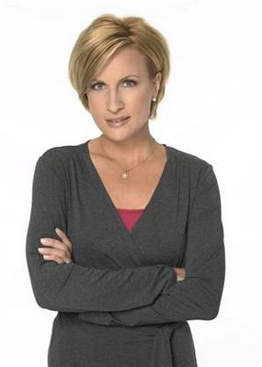



Body Language
workbook – page 9

Slide 21
Watch Mark Sanborn’s 3 Channels…
Mark Sanborn Video

Slide 22
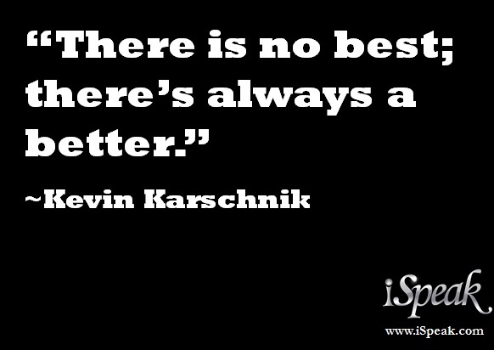
Exercise:
Famous Quotes
workbook - page 11

Slide 23
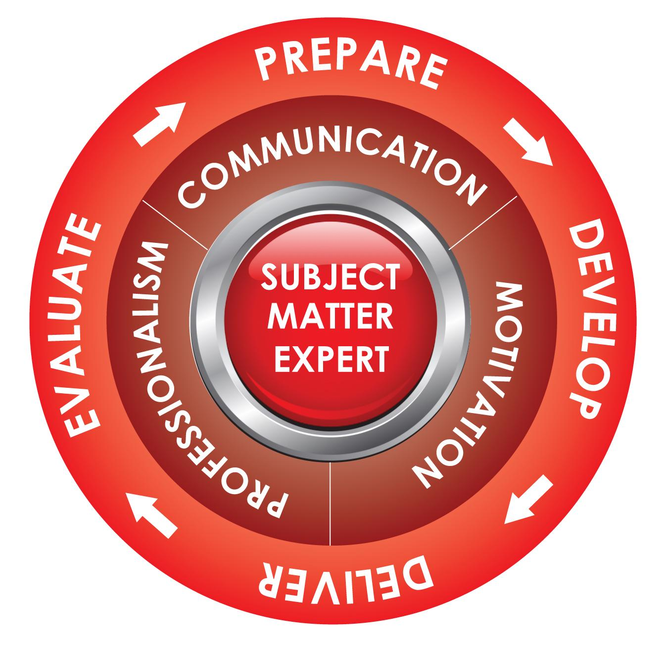
Presenting is a Process
workbook - page 12

Slide 24
Unit Two:
Preparing Your Presentation

Slide 25

Presentation Purpose
Know: What do I want the audience to understand, believe, or think about what I am presenting?
Feel: How do I want the audience to feel about this information? Inspired? Worried? Confident?
How do I want them to feel about me?
My company? My department?
Do: What action do I want the audience
to take as a result of the presentation?
workbook - page 16

Slide 26
Audience Analysis
WHO? Who are they?
KNOW? What do they know?
CARE? How much do they really care?
workbook – page 17

Slide 27

Exercise: Write your
Audience Analysis

Slide 28
Know your audience
JC Anderson Golf Video

Slide 29

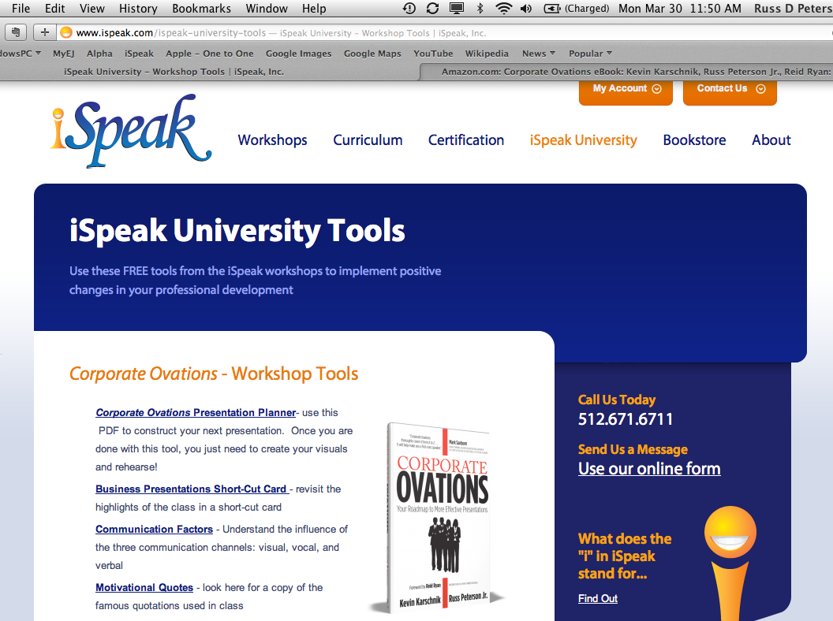
iSpeak Presentation Planner
workbook - page 19

Slide 30
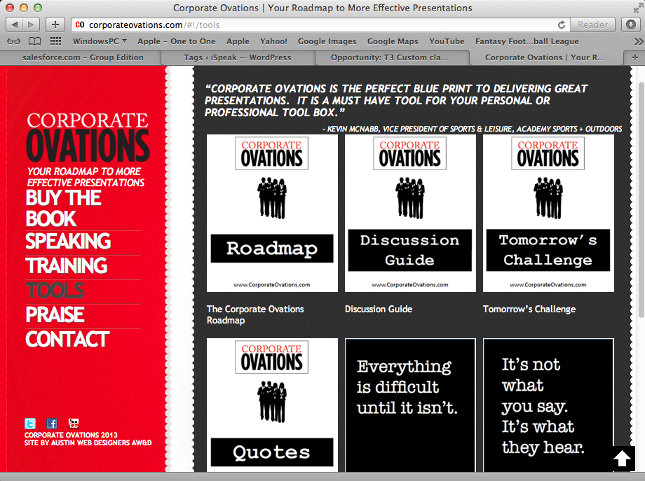
CorporateOvations.com
More FREE Tools

Slide 31
Satori
Page 51

Slide 32

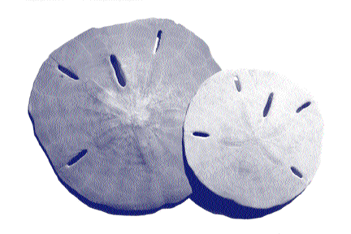
Unit Three:
Developing Your Presentation
workbook – page 21

Slide 33
Presenting is a Process

Slide 34
How NOT to open a presentation
Poor Presentation Opening Video
workbook – page 22

Slide 35




Credibility
Attention
Body
Audience

Slide 36
Bill – CABA Video
(Tier 3 Engineer Internet going up and down video)
Notes:
Bill shares an example of CABA as an engineer giving an update on his research.
Attention – Frustration of internet going up and down, over and over (a little audience here too because of the ‘frustration’ they would feel)
Audience – These are the calls you and I have been receiving (in other words… I feel your pain! I know what you are going through!)
Credibility – As the Tier 3 Engineer, I’ve looked at the data, run tests and determined where the issue is. Notice he DIDN’T – Introduce himself by name or say how long he’s been a Tier 3 Engineer, which is what so many people do for the credibility piece! (Excellent credibility example without saying his name and how long he’s been doing something)
Body – He shared the 3 things he is going to give to the audience today in his presentation.
BTW, Bill is 6 ft, 11 inches tall.
;-)

Slide 37
Credibility
Attention
Body
Audience

Slide 38


Slide 39
Credibility
Attention
Body
Audience

Slide 40
Attention
Statement
Quote
Question
Story

Slide 41
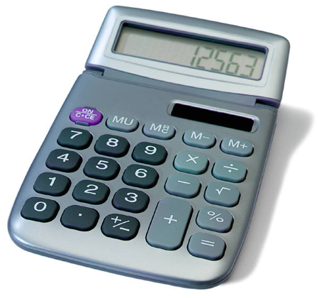
Attention: Statement
Cost
Savings
ROI
Hours
Reflection
316,000

Slide 42
Attention
Statement
Quote
Question
Story

Slide 43
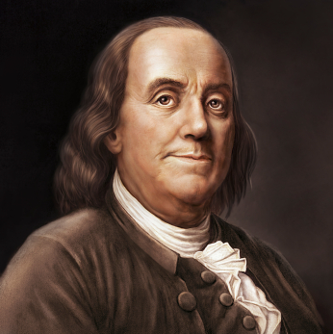
“A penny saved is a penny earned.”
Benjamin Franklin

Slide 44
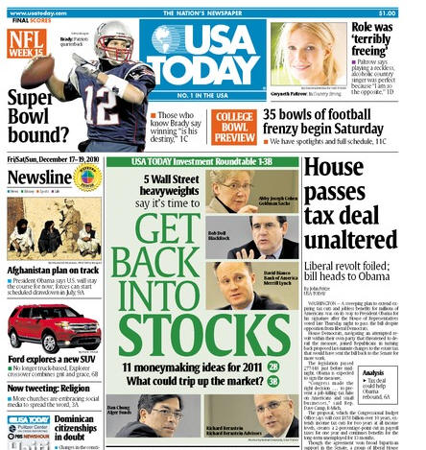
Attention: Quote
Your CEO!
Newspaper
Bill Gates
Audience member
Customer

Slide 45
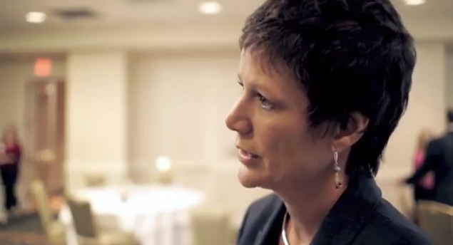

“iSpeak delivers on what they promise. No matter where it is in the world, I know they’ll deliver on their promise.”
Shelley Robbins,
Sr. Manager,
Organizational Development

Slide 46
Attention
Statement
Quote
Question
Story

Slide 47

“How much…?”
“What is…?”
“How many…?”

Slide 48
Attention
Statement
Quote
Question
Story

Slide 49


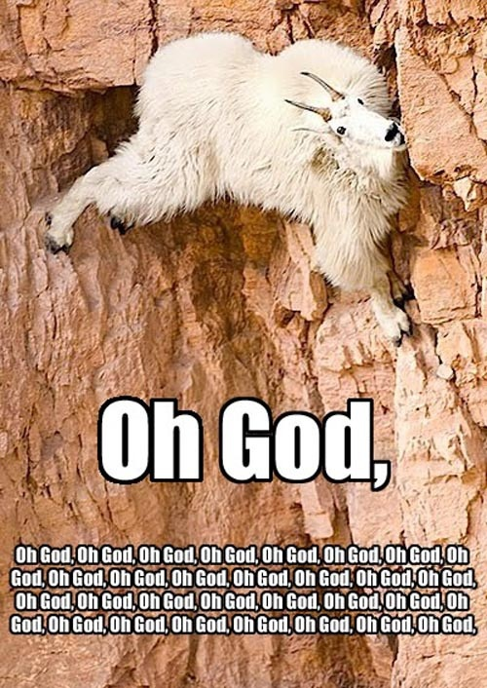
What kind of stories?
Struggle
Success
Humor

Slide 50
Credibility
Attention
Body
Audience

Slide 51
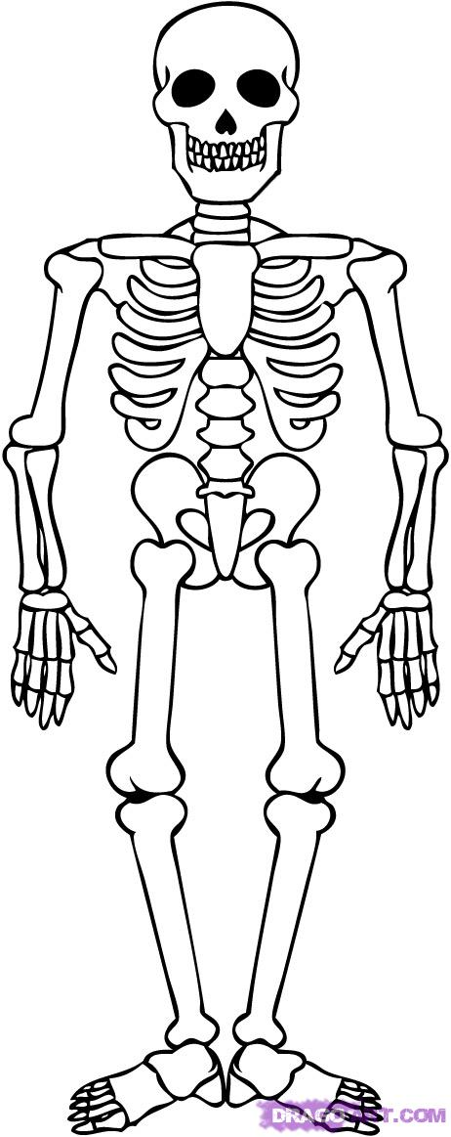
Body

Slide 52


Slide 53
Credibility
Attention
Body
Audience

Slide 54

Audience

Slide 55
WHY…
should I listen?

Slide 56
Credibility
Attention
Body
Audience

Slide 57
Cynthia Keynote CABA Example Video
Notes:
Cynthia Oelkers provides and example of CABA used in a Keynote address (from a large stage). She is playing the role of a Sr. Executive (VP of Digital Marketing) speaking to her entire organization, possibly at an annual National Sales Conference. Her point to the group is that leveraging digital technology to attract the “digital native” is a very real opportunity for their future. They should start by making changes to the website to attract those digital natives and allow them to interact the way they want to!
Attention – Cynthia shares a story about both her children interacting with common devices as if they should be on the internet. This story is humorous, but the audience can definitely relate to it. It also pulls the audience in to understand the importance of this next generation. They grew up in a connected world and they will expect simplicity and connection in all they interact with.
Credibility – As the VP of Digital Marketing at D&B… (Excellent credibility example without saying her name and how long she’s been doing something.)
Audience – If you’re like me… get them to buy off our website! … so we don’t fail like blockbuster and Taxi’s who don’t leverage technology!
Body – Share 3 things to make sure our websites are ready for the next generation

Slide 58
Kevin Sales Manager CABA Video
Notes:
Kevin Karschnik is playing the role of a Sales Manager. He looked at some data and is going to share with the team what he discovered and how they can leverage this info for improvement over the next quarter.
Credibility – I pulled all of our sales numbers and reviewed them. I found something interesting. (He is uniquely qualified to be speaking to the group right now because HE did the research and HE made the discovery. Excellent credibility example without saying his name and how long he’s been doing something.
Attention - “I found something interesting…” This statement serves a dual purpose, enhances his credibility (as a researcher!) and creates intrigue and curiosity in the audience. “80% of our sales come from 20% of our customers.” This is a fact or statement used to grab attention.
Body – Today he is going to share the highlights (good), the low-lights (bad), and the opportunities (new) for the next quarter.
Audience – So that… they all have a clear direction and focus and so that they can all be successful.
TRANSITION – Kevin does a great example here by ending his opening with a transition to the body. This transition type is a Question for the audience. The answer to the question will lead Kevin directly into his first key point in the body (the best customer or one of the Highlights of the year.)
NOTE: Your students may point out that they thought the transition question was the “Attention” piece of the CABA opening. As an instructor, you can respond by telling them, “Our job as speakers is to create flow by generating interest in the audience to always hear what’s coming next! They WANT to turn that next page, they WANT to hear what’s next. This is a great example Kevin uses. The question is another piece that grabs their attention and makes the audience want to listen to the next part of his presentation.

Slide 59
Cynthia Group Meeting CABA Video
Notes:
Cynthia Oelkers demonstrates how to use the CABA method in a more casual, group meeting around a conference table. She’s playing the role of a lead project or team manager. The discussion is going to center on how they will approach a website redesign for their non-profit customer.
Credibility – We’ve run the analytics on their website and we’ve made a few discoveries… (the group reports to Cynthia and they don’t need her name or her resume. Cynthia merely shows she has done her homework to prepare for this meeting. She has run the analytics, reviewed them, AND in her review, she’s made some discoveries.
Attention – She asked a question of her team, “What do you think is the most often clicked spot on their website?”
Audience – Participation from the audience first with answers to her question. This is engaging to small groups and makes them feel heard and connected. Notice how Cynthia does a GREAT JOB of handling responses from her team when they are WRONG. She does not make any member feel “less than” for answering incorrectly. This is important in small group settings like this because she maintains a safe environment where all answers are appreciated. Then Cynthia comments on their users clicking on a story about a little girl, but there is no ultimate ending of a donation, “We know that doesn’t drive donations!” This connects her to the audience and pulls them together as a team… “We all know this.”
Body – So, I’m going to take us through 3 areas we can help… Google Analytics, Heat Maps, and Focus Groups.
Transition: Let’s get started…

Slide 60
Russ Sr. Project Manager CABA Video
Notes:
Russ Peterson Jr. is playing the role of a Sr. Program Manager in charge of provisioning (delivering) projects to the external customer once the sales team has sold the deal.
Attention – Russ begins with a quote to grab attention. The person quoted is the Western Region Sales VP, Jim. Russ quoted an internal person from his own company, but Jim is someone who played a critical role in selling this large deal. Jim has helpful information from working directly with the customer during the sales process. Jim’s advice should grab everyone’s attention! Another technique used by Russ in the attention section is a storytelling technique. He uses dialogue. In other words, he “became” Jim for a moment and “acted out” what Jim said, “I’ll tell you in one word, Provisioning!” Dialogue captivates audiences, even in small doses like this.
Audience – “If we get this right we will have (benefit) with happy customers, internal management, and an opportunity for everyone to get the spotlight.
Credibility – Russ doesn’t give his name or his title for credibility. He only says that over the years, he’s seen lots of projects, but this is the biggest.
Body – Russ closes the Intro by telling the group what they are going to review today. In other words, “Here’s our roadmap. Now let’s get to it.”

Slide 61
Exercise: WRITE
YOUR OPENING
workbook - page 26

Slide 62
Presentation #2
Topic: Presentation CABA Opening
Time: Ranging from 1-minute
to 2-minutes
Feedback on:
  Previous Strengths/Areas to Improve
  CABA
  Flow
  Communication
  Delivery

